Slide 1

Exercise 1
BIF2

Slide 2
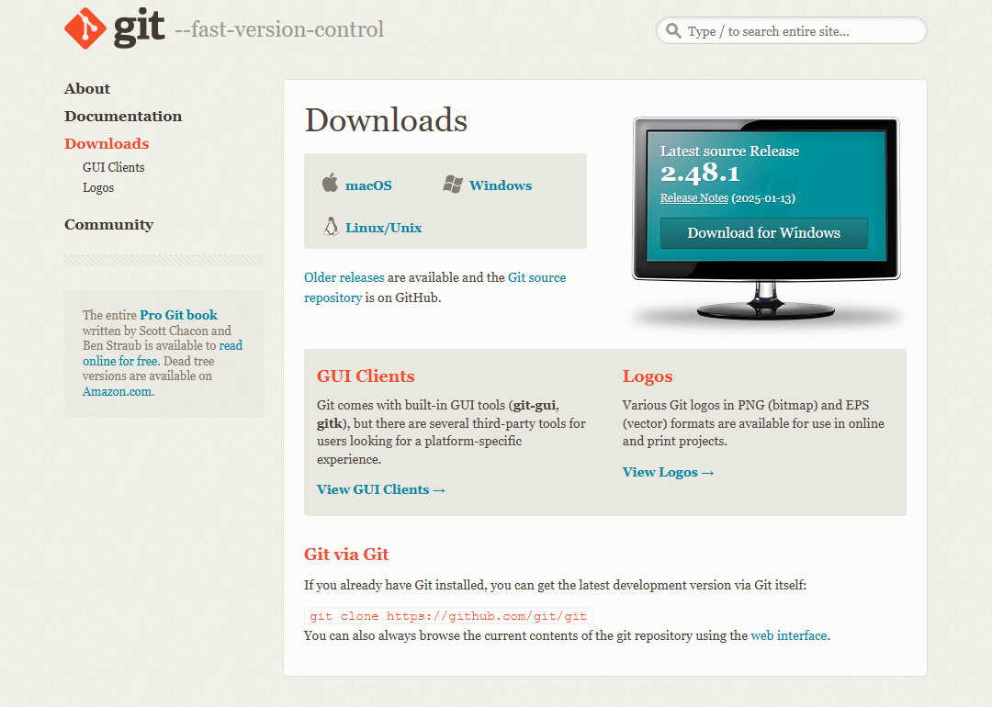
Install the Git Bash
Link
https://git-scm.com/downloads
Operating System
Windows

Slide 3
The first repository
Create the first repository in a folder of your choice.
What is the command for it?
What are the options?
What exactly happens in the process?

Slide 4
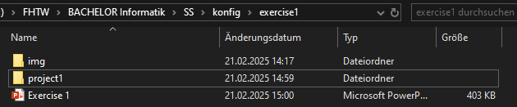

The first repository
COMMAND
$ git init [directory]
Creates new folder and initializes Git-Repository
Other option
$ git init
Current folder will be initialized as Git-Repository

Slide 5
Global config
To set up your name and email address one, configure it via git config.
What is the full command?
What options are there?
Where are global setting stored in Git?

Slide 6
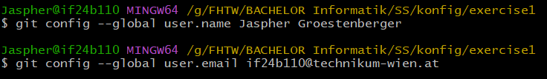
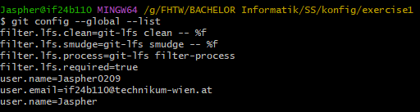
Global config
COMMAND
$ git config --global user.name “[name]”
user.name = Jaspher
$ git config --global user.name “[email adress]”
user.name = if24b110@technikum-wien.at
$ git config --global --list
Shows entire list of global configurations
Where are global setting stored in Git?
Inside ~/.gitconfig
(‘~’ is short for home-directory)

Slide 7
Text file
Create a text file and write into it.

Slide 8
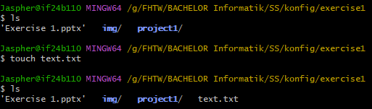
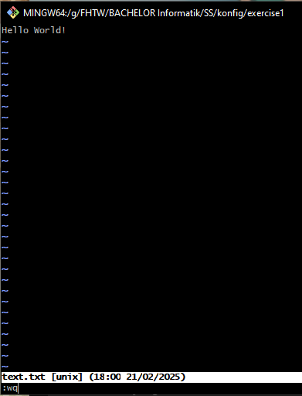
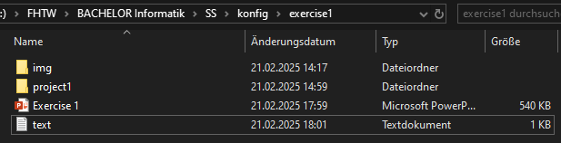

Text file
Creating text file
vi (Visual Editor )

Slide 9
Status
On the Git Bash, check the status.
What is the command for this?
What result do you get and how do you interpret it?

Slide 10
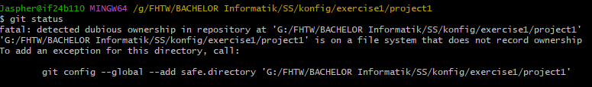
Global config
COMMAND
$ git status
Interpretation of result
Detect dubious ownership: Due to repository location in external drive

Slide 11
Global config
Solution
Command:
$ git config git config --global --add safe.directory 'G:/FHTW/BACHELOR Informatik/SS/konfig/exercise1/project1'

Slide 12
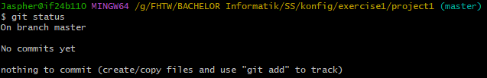
Global config
Repeating action
Interpretation of result
(master) appears next to directory-path
Git-repository is located on the branch “master” (Standard-Branch) > ‘On branch master’
Shows that there are no commits yet > ‘No commits yet’
No existing changes to commit > ‘nothing to commit’

Slide 13
Put file in the repository
Put file in the repository.
Now What are the commands for doing this?
What steps are necessary and what results do you get?
How do you interpret the output?
Where does Git store the files?

Slide 14
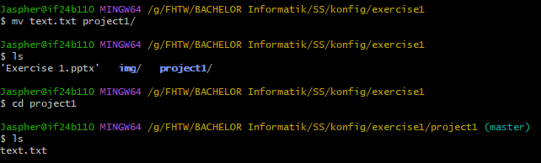
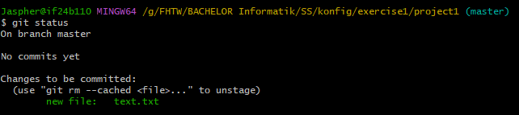
Put file in the repository
COMMAND
$ git add [filename]
Steps adding file to repository
File should be inside repository
Result
File is now in Staging-Area – Ready to commit
It was untracked first – Files that Git does not know about
Status check with $ git status

Slide 15
SHA1
You have now created Git Objects.
Which ones (according to the Data Model) and where are they located?
How can you find the SHA1 key of the blob object?
What is the command for this?

Slide 16
SHA1
COMMAND
$ git ls-files --stage [filename]
Lists all files Git is currently tracking
--stage is to outputs staging information plus SHA1 hash of object
Objects
Blob (Binary Large Object)
Tree
Commit
Tag
Location: .git/objects/

Slide 17
Search and output via SHA1
How can you output the contents of the file only by specifying the SHA1 key?
What is the command and what options does it provide?

Slide 18
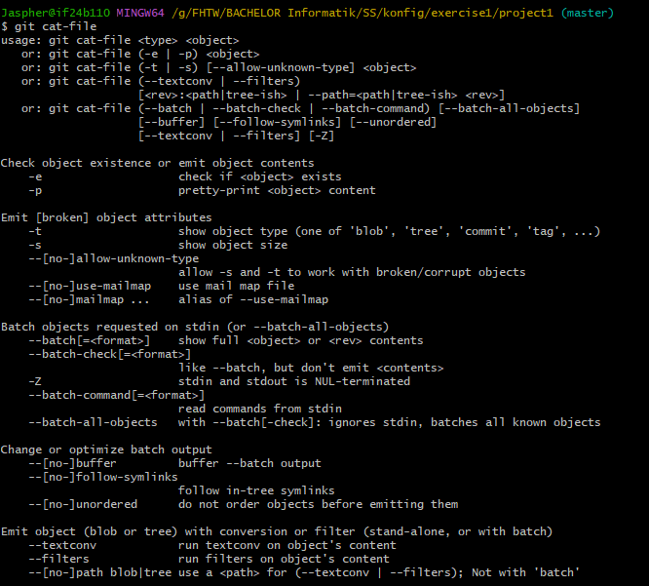
SHA1
COMMAND
$ git cat-file -p <SHA1>
Outputs content of file by specifying SHA1
cat-file: outputs content
-p: outputs readable content of specified object
Options

Slide 19
SHA1 Hello World
What is the SHA1 key of the text “Hello World!”?
Do not create a separate file for this!
What is the command for this?

Slide 20
SHA1 Hello World
COMMAND
$ git hash-object [option] <filename>
Command to hash text content
Echoes text to console
-git hash-object --stdin hashes the standard input of console

Slide 21
Save Hello World
Save the text “Hello World!” in the repository without creating a file for it.

Slide 22
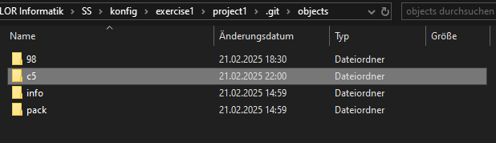
Save Hello World
“Hello World!” saved in repository

Slide 23
Blobs
You have now created the first 2 blob objects in the repository. Now create the first commit object.
Which command do you use it for it?
What options does it offer?
Where are commit objects stored?

Slide 24
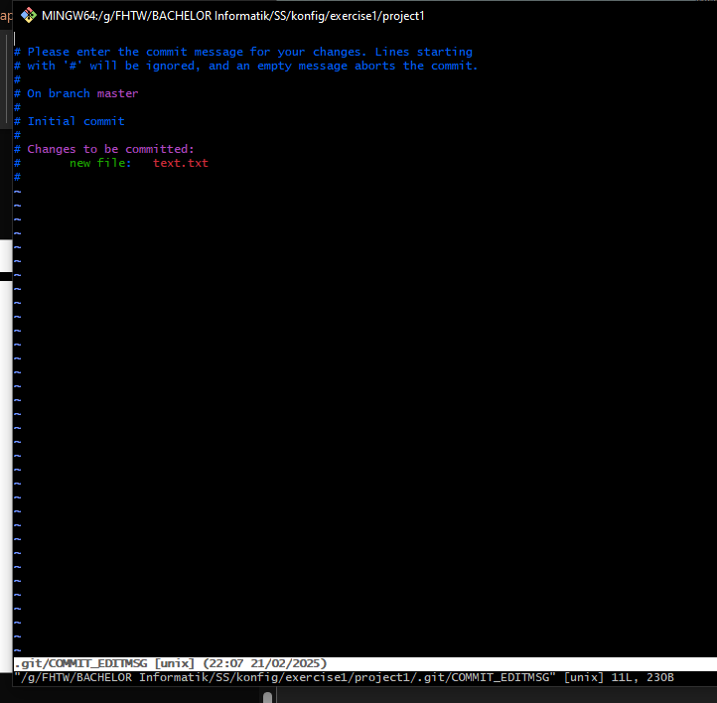
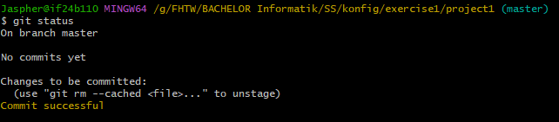

Blobs
COMMAND
$ git commit –m “[descriptive message]”
-m outputs descriptive message after commit
$git commit without -m

Slide 25
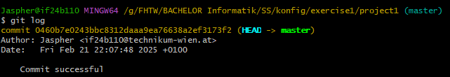
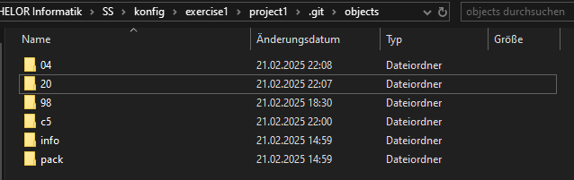
Blobs
Commit stored in: ./git/objects
It’s the 04 directory

Slide 26
History output
In order to be able to display the history on the screen, you must use:
Enter command: git log --graph --decorate --oneline --all
We don’t type long command everytime -> new alias(git lol)
What command do you enter for this?

Slide 27
History output
COMMAND
$ git config –global alias.<alias-name> “<git-command>
Configurates new alias for a git command

Slide 28
History
With git lol we can now output the history any time.
What does the history look like?
0460b7e: hash-value of commit object
(HEAD -> master): HEAD points on master branch
Commit successful: previous commit descriptive message

Slide 29
New file
In Create another file and add it to the repository. Also create new version of your repository.

Slide 30
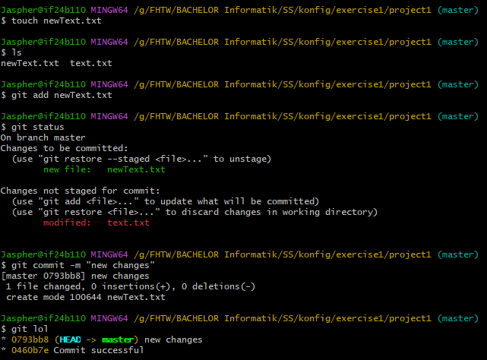
New file
New file added to repository and creates new version of repository.

Slide 31
Commit object
Oops, now you have forgotten a file.
Create a third text file and add this file to the repository.
But make sure to that this file still goes into the same version of the history by using the amend command.
Does git create a new commit object?
If so, why?

Slide 32

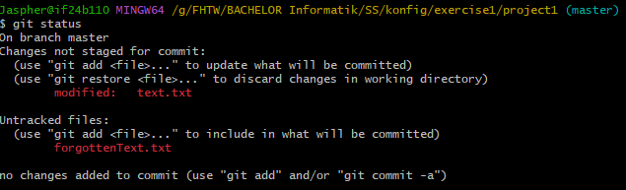
Commit object
COMMAND
$ git commit --amend –m “[descriptive message]”
A way to make quick corrections without creating new commits.
Fixing commit message or adding new changes
Does it create a new commit object?
Technically yes, it does but replaces the previous version in the history.

Slide 33
Delete
Delete a file and then restore it using commands.
What command do you use for this?
From where is the file restored?

Slide 34
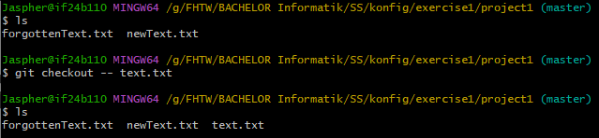

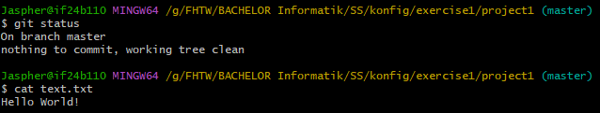
Delete
COMMAND
$git rm [filename]
Removes file
COMMAND
$git checkout -- <file-name>
Restores changes in working directory

Slide 35
Modify files
Modify the contents of the first file. Display the status in Git.
What does the output look like and how do you interpret it?
How do you commit the changes?
What happens in the repository?

Slide 36
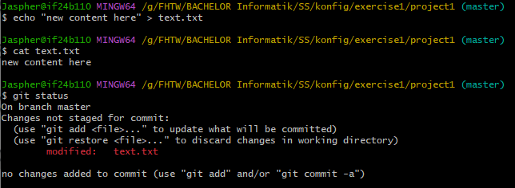
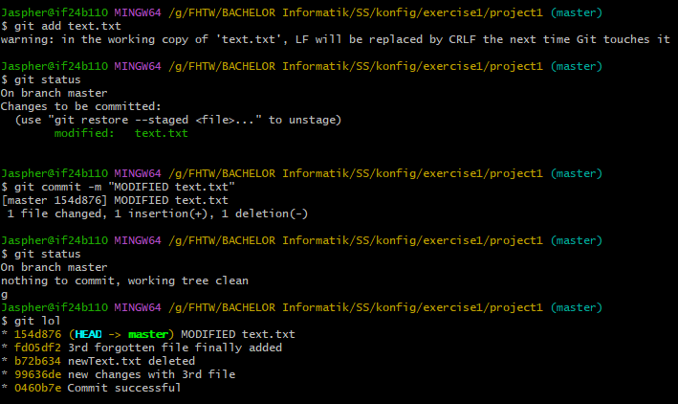
Modify files
Content of text.txt modified
$ git status
In red, it shows, that text.txt got modified
What happens to repository?
Changes are saved in commit
Commit is recorded in repository’s history
File’s state is now part of the repository’s commit history
How to commit the changes?
After modifying content of file, add text.txt to repository again
Commit the changes

Slide 37
Checkout
Look at the history andtry to go back to the penultimate version.
Now look at the history again.
What does HEAD mean?
What is main/master?
What other options does the command you just used offer?

Slide 38
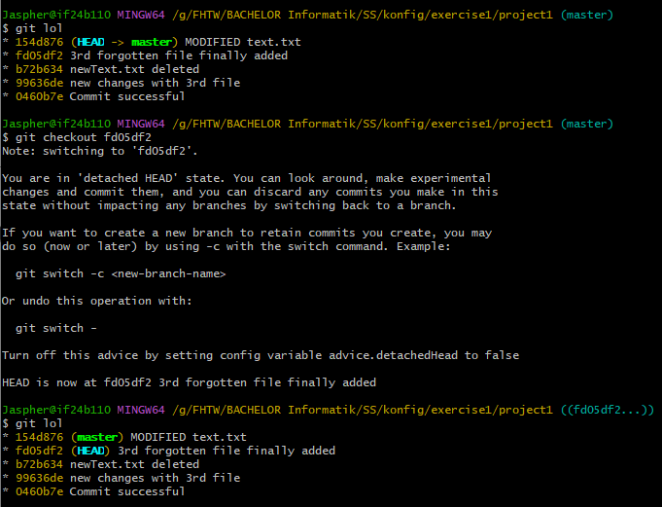
Checkout
COMMAND
$ git checkout <SHA1-Key>
What happened?
The HEAD just moved from the top commit to the one below.
Next to path-directory, (master) changed to (SHA1 - key) of HEAD current position
What does HEAD mean?
It refers the current commit or current branch the user is working on.
What is main/master?
It is the default branch in a repository

